Slide 1
Installing kubernetes
Rode Kruis Ziekenhuis Beverwijk

Slide 2
Bootstrapping cluster with kubeadm

Slide 3
Installing container runtime
1. Set up Docker's Apt repository.
# Add Docker's official GPG key:
sudo apt-get update
sudo apt-get install ca-certificates curl gnupg
sudo install -m 0755 -d /etc/apt/keyrings
curl -fsSL https://download.docker.com/linux/ubuntu/gpg | sudo gpg --dearmor -o /etc/apt/keyrings/docker.gpg
sudo chmod a+r /etc/apt/keyrings/docker.gpg
Notes:
https://docs.docker.com/engine/install/ubuntu/#prerequisites
https://docs.docker.com/engine/install/linux-postinstall/
https://docs.docker.com/engine/install/ubuntu/

Slide 4
# Add the repository to Apt sources:
echo \
"deb [arch="$(dpkg --print-architecture)" signed-by=/etc/apt/keyrings/docker.gpg] https://download.docker.com/linux/ubuntu \
"$(. /etc/os-release && echo "$VERSION_CODENAME")" stable" | \
sudo tee /etc/apt/sources.list.d/docker.list > /dev/null
sudo apt-get update

Slide 5
Install the docker packages:
sudo apt-get install docker-ce docker-ce-cli containerd.io docker-buildx-plugin docker-compose-plugin
Verify that the installation is successful by running:
sudo docker run hello-world
Notes:
Thank you .
after installing docker ( I am following the https://docs.docker.com/engine/install/ubuntu/ )
I was able to do below step as you suggested
sudo rm /etc/containerd/config.toml
sudo systemctl restart containerd
sudo kubeadm init
Swapoff -a

Slide 6
CRI-dockerd
https://github.com/Mirantis/cri-dockerd/releases
Notes:
https://github.com/Mirantis/cri-dockerd/releases

Slide 7
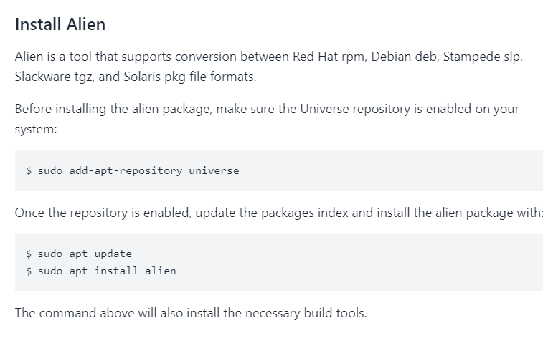
Notes:
https://linuxize.com/post/install-rpm-packages-on-ubuntu/?utm_content=cmp-true

Slide 8
Installing kubeadm
1. Update the apt package index and install packages needed to use the Kubernetes apt repository:
sudo apt-get update
# apt-transport-https may be a dummy package; if so, you can skip that package
sudo apt-get install -y apt-transport-https ca-certificates curl
Notes:
https://kubernetes.io/docs/setup/production-environment/tools/kubeadm/install-kubeadm/

Slide 9
2. Download the public signing key for the Kubernetes package repositories. The same signing key is used for all repositories so you can disregard the version in the URL:
curl -fsSL https://pkgs.k8s.io/core:/stable:/v1.28/deb/Release.key | sudo gpg --dearmor -o /etc/apt/keyrings/kubernetes-apt-keyring.gpg
3. Add the appropriate Kubernetes apt repository:
# This overwrites any existing configuration in /etc/apt/sources.list.d/kubernetes.list
echo 'deb [signed-by=/etc/apt/keyrings/kubernetes-apt-keyring.gpg] https://pkgs.k8s.io/core:/stable:/v1.28/deb/ /' | sudo tee /etc/apt/sources.list.d/kubernetes.list

Slide 10
4. Update the apt package index, install kubelet, kubeadm and kubectl, and pin their version:
sudo apt-get update
sudo apt-get install -y kubelet kubeadm kubectl
sudo apt-mark hold kubelet kubeadm kubectl

Slide 11
Swapoff –a
sudo rm /etc/containerd/config.toml
sudo systemctl restart containerd
sudo kubeadm init
Sudo kubeadm join ip-address --token X --discovery-token-ca ...

